Slide 1
Docker Fundamentals
Suman Debnath

Slide 2
Agenda
Introduction to Virtualization Technologies
Container based Virtualization
Docker Architecture
Docker based Web-Application

Slide 3
It’s all about Applications

Slide 4
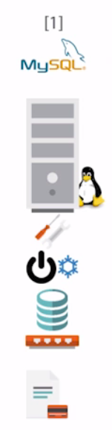
Server : Application 1 : 1

Slide 5
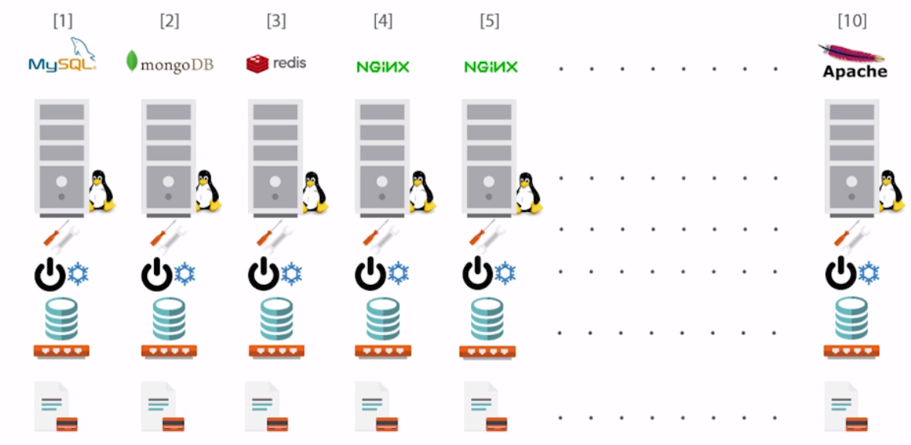
Server : Application 1 : 1

Slide 6
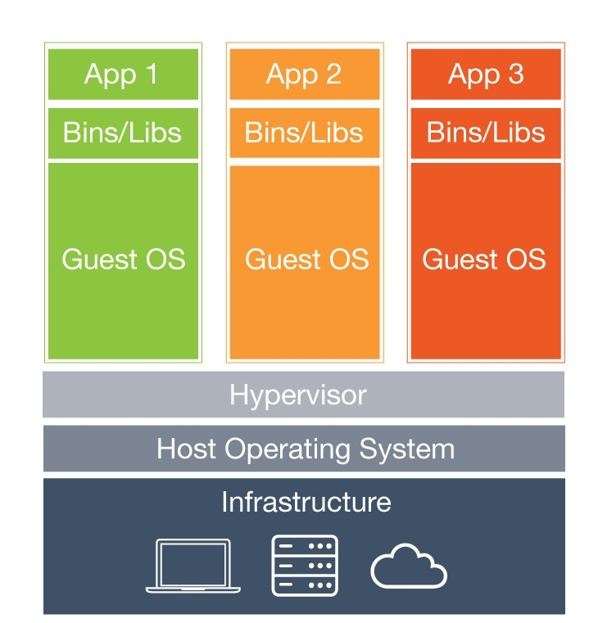
Hypervisor
Beneﬁts:
Cost-Eﬃcient
Easy to Scale
Limitations:
Kernel Resource Duplication
Application Portability Issue

Slide 7
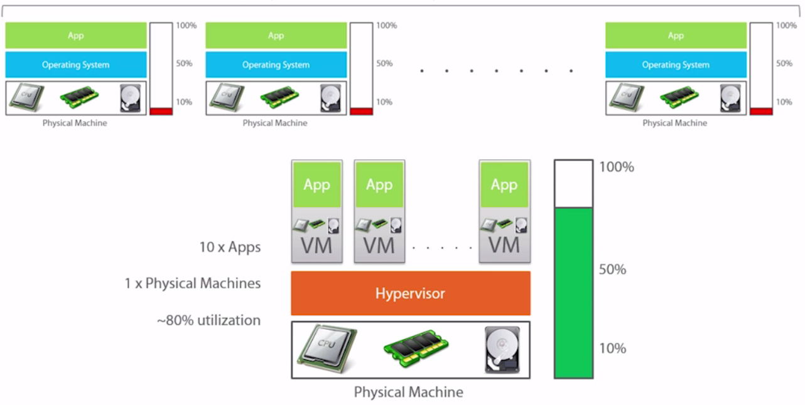
Server : Application 1 : 10

Slide 8
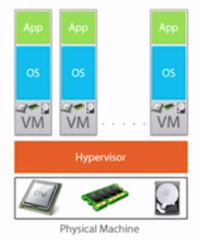
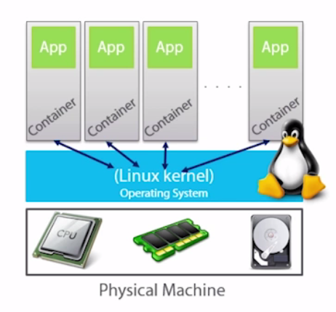
Containers
VM Model

Slide 9
Containers
Consumes less CPU, RAM, disk resources than Virtual Machine
A container is just the application and its dependencies
It runs as an isolated process in user space on the host OS

Slide 10










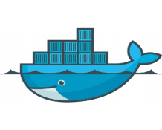


Runtime Isolation
Application A
Application A
JRE 8
JRE 7
Container A
Container B
Container Engine(Docker)
Operating System/Kernel
Physical Server

Slide 11
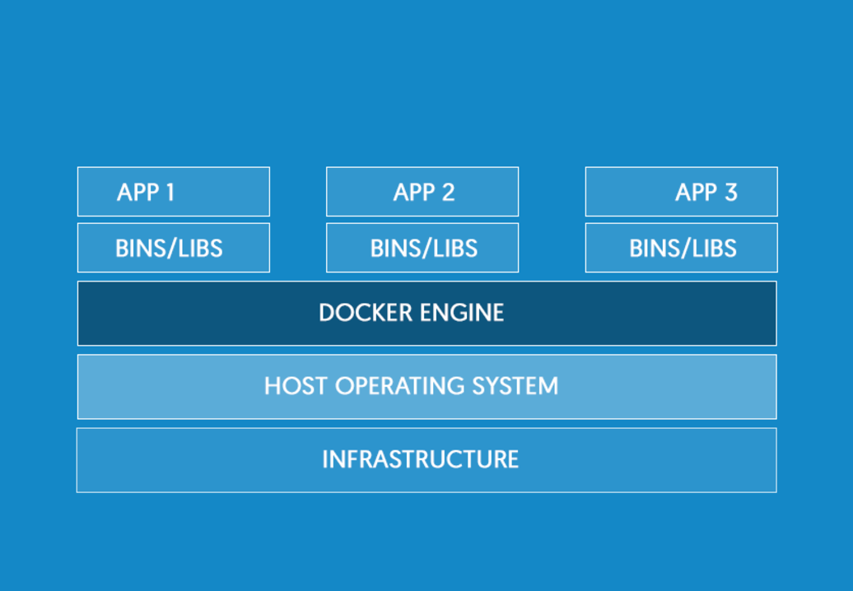

Docker
Docker engine provides environment to package, deploy and manage applications within containers
Docker containers wrap up a piece of software in a complete file system that contains everything it needs to run: code, runtime, system tools, system libraries
Uses resource isolation features of the Linux kernel, like, namespaces, cgroups, union file systems
Container1
Container2
Container3

Slide 12
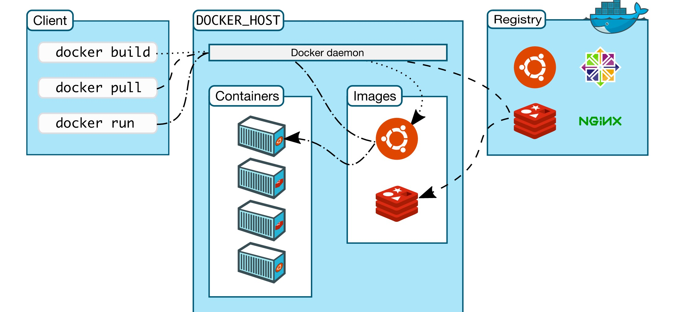
Docker Architecture

Slide 13
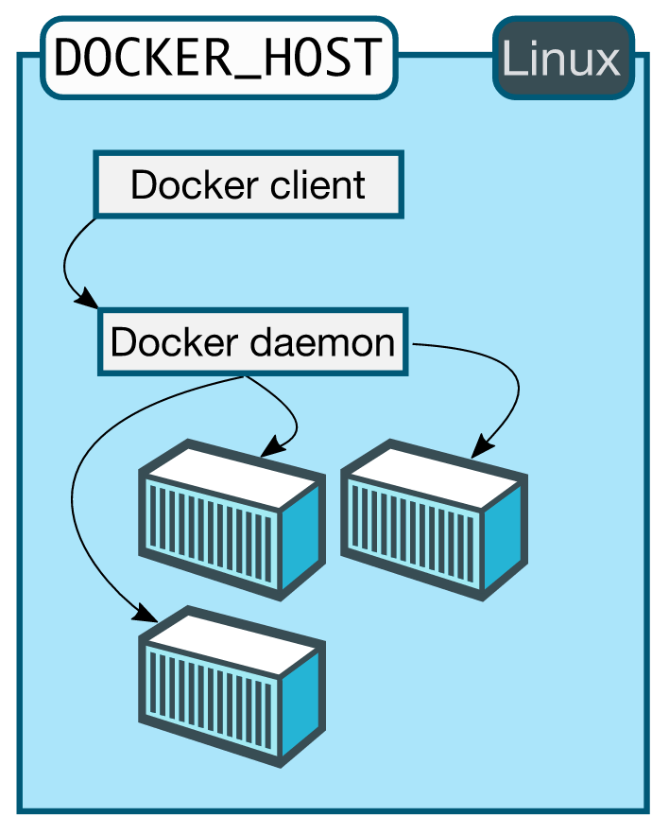
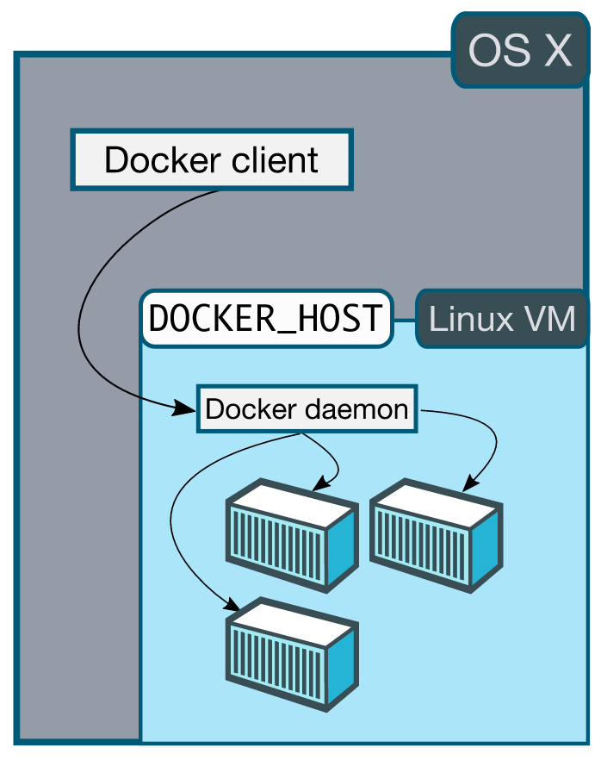
Docker Architecture

Slide 14
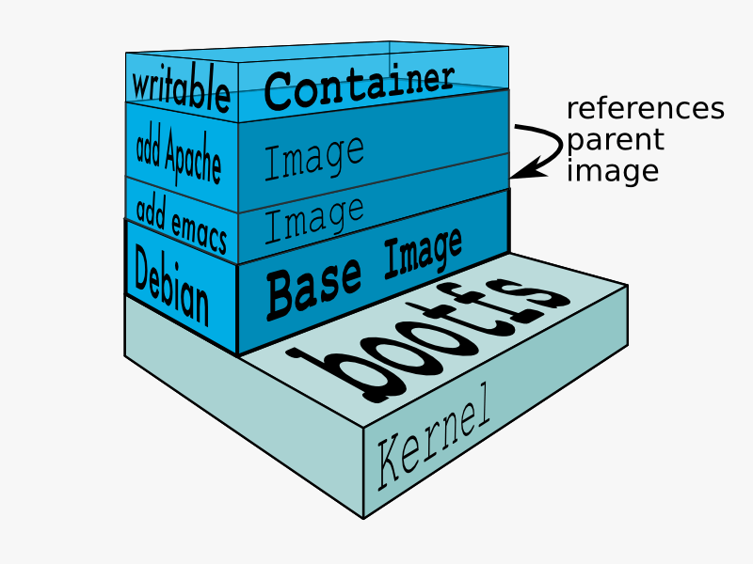
Images
Images are read only templates used to create containers.
Images are created with the docker build command, either by us or by other docker users.
Images are composed of layers of other images.
Images are stored in a Docker registry.

Slide 15
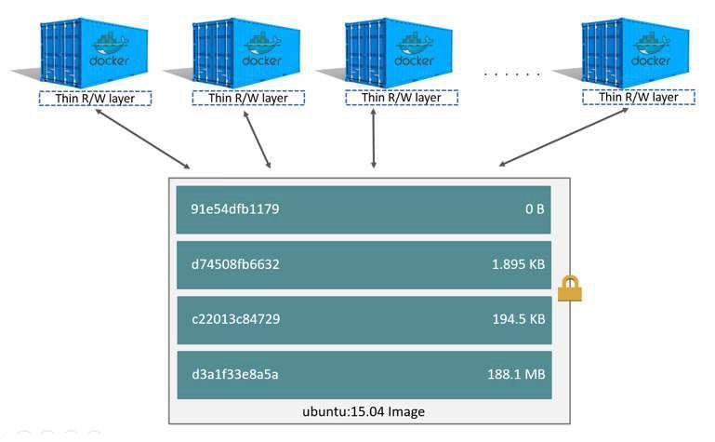
Image Layers

Slide 16
Installation

Slide 17
Demo

Slide 18
Why are containers important to your customers?
Developers
System Admins
It is fast and agile, containers help developers build and ship higher-quality apps faster
Developers can quickly build an app in any language, using any tool chain
Containerized apps are portable and can run on any Linux/Windows OS
e.g., Can do QA/build on Ubuntu and then run production on Red Hat
SysAdmin use containers for their standard and simplistic deployment
Reduces the finger pointing of app dependency and “it works on my machine”
Abstract away the underlying OS and hardware platform, making the application portable
DevOps Transformation

Slide 19
What Next..

